Slide 1
Early Stage diabetes risk prediction dataset. Data Set
UCL Data repository: https://archive.ics.uci.edu/ml/datasets/Early+stage+diabetes+risk+prediction+dataset.

Slide 2
Objective
Data Mining method: Classification
y-label: result (positive or negative)
Specific algorithm: Decision Tree

Slide 3
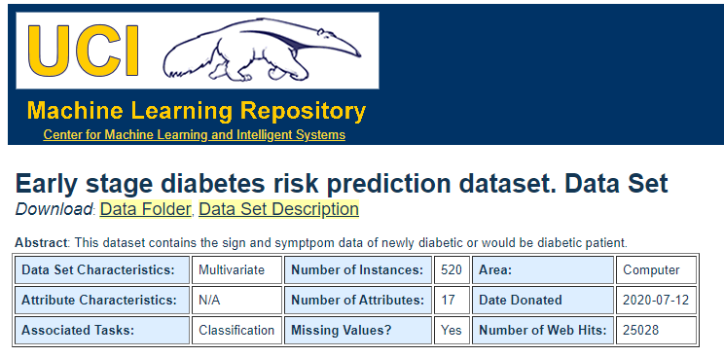
This data comes from the UCL Data repository. It has information about patients in Sylhet Diabetes Hospital in Sylhet, Bangladesh. The patients are male and female, ranging from 20-65 years old. This dataset has 17 attributes to it.

Slide 4
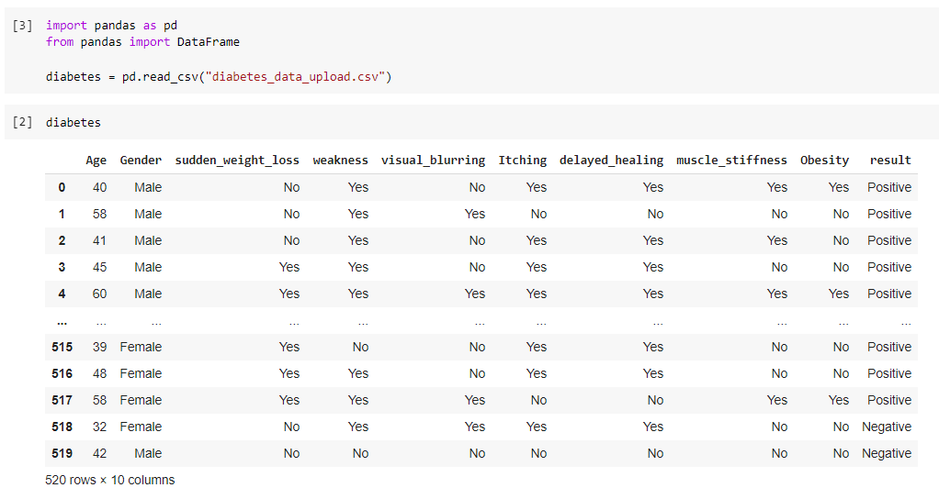
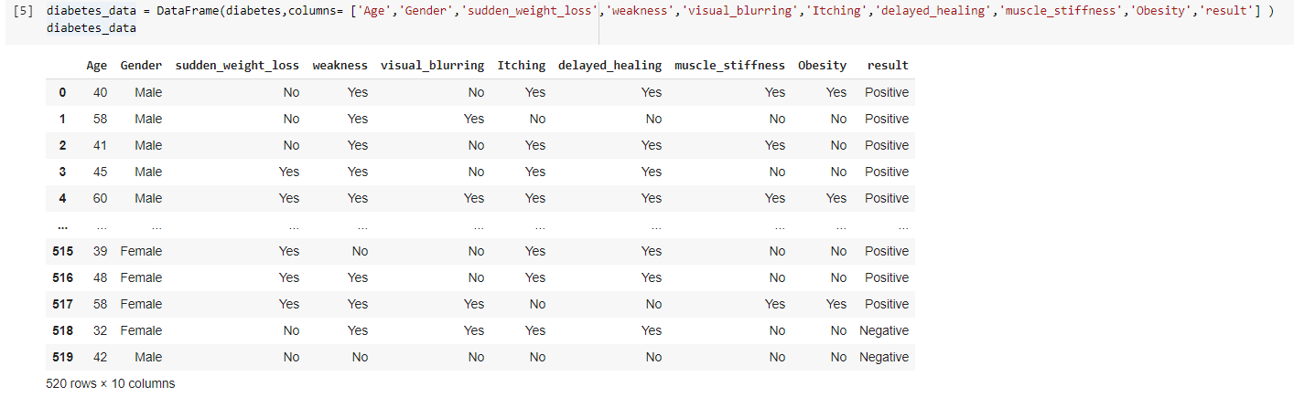
The data set

Slide 5
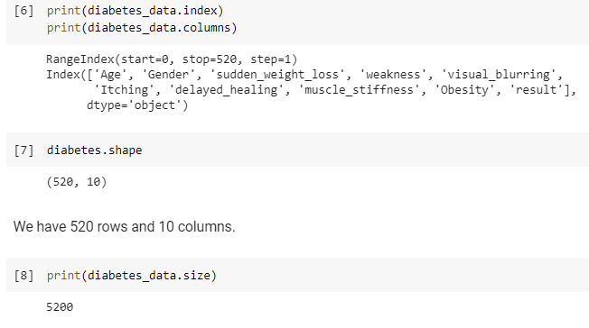
Making sure

Slide 6
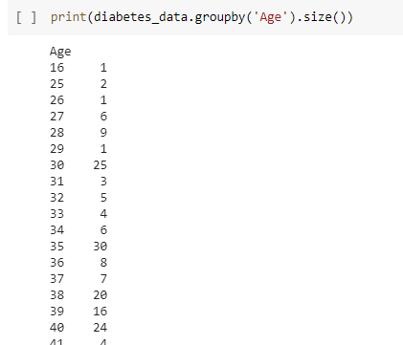
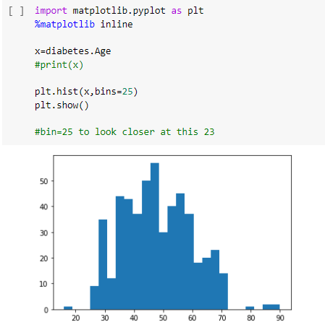
How many people are in what age ?

Slide 7
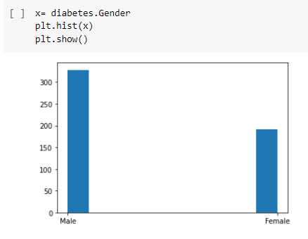
How many male vs female

Slide 8
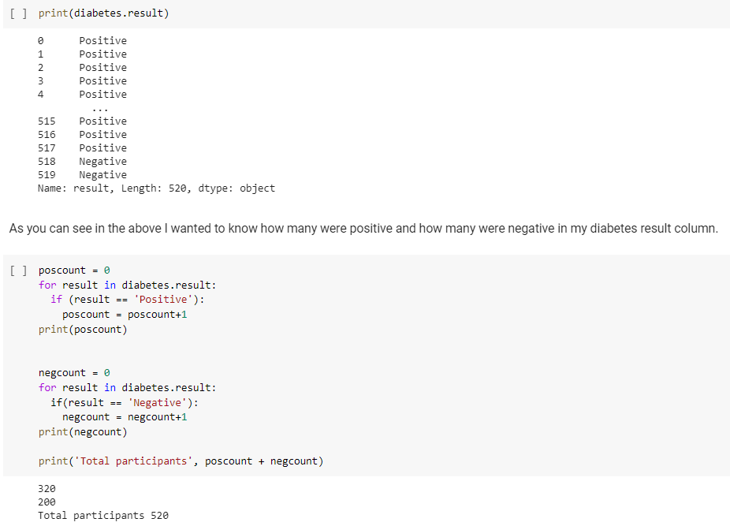
How many in total were positive vs negative

Slide 9

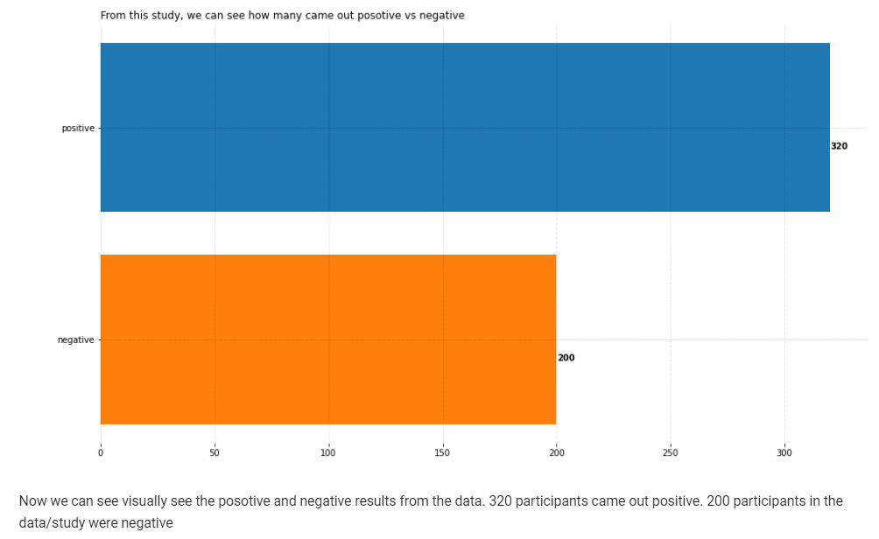

Slide 10
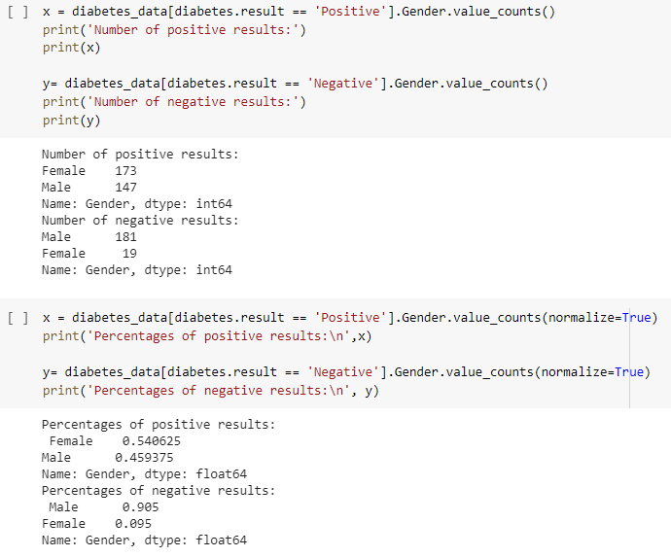
How many of those positive/negative results were for male/female ?

Slide 11
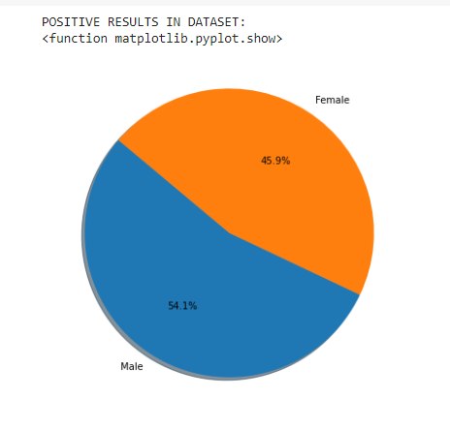
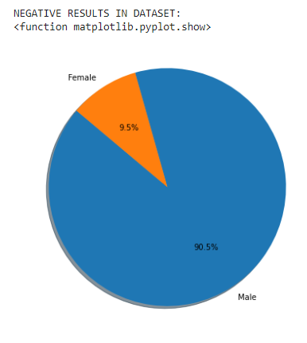
Positive results
Negative Results

Slide 12
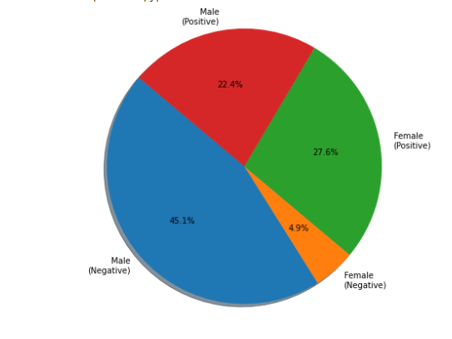
Putting both results into one pie graph

Slide 13
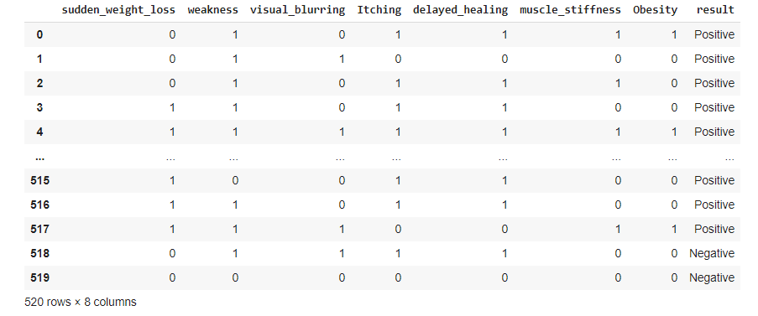
Decision tree making
Edited the csv file to turn the yes and no answers to binary. No =0 ; Yes=1

Slide 14
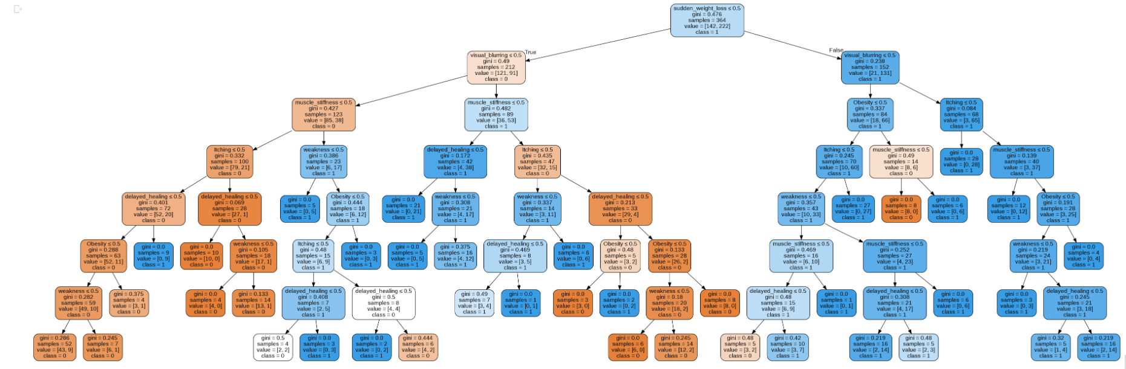
Decision tree

Slide 15
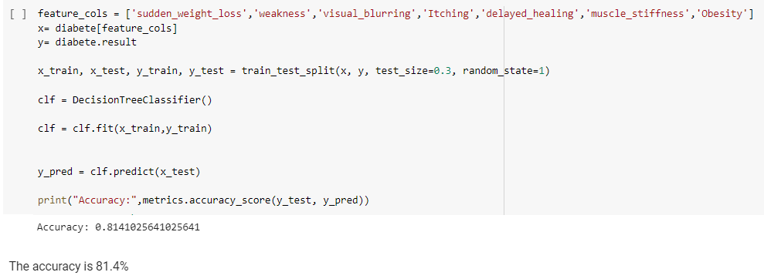
Accuracy

Slide 16
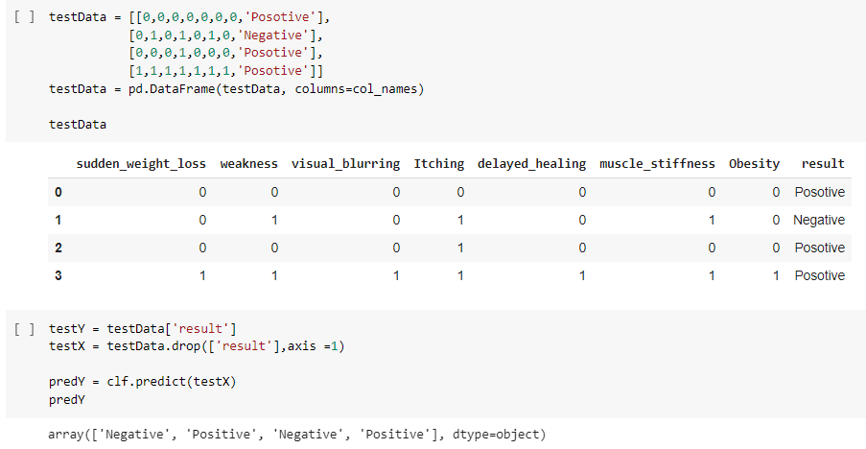
Testing

